Slide 1

AlitQ Mart
Supply Chain Analysis
April, 10th 2025

Slide 2
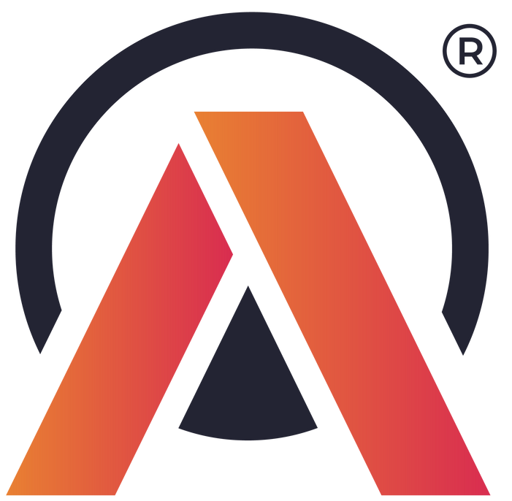
Company's background
AlitQ Mart:
FMCG Manufacturer, India
Operate in Ahmedabad, Surat, Vadodara
Business problem:
Only a small number of customers renew their annual contracts because of the service quality

Slide 3
Table of Contents
PL300-127 - Nguyen Vu Ngoc Chau
Key Metrics
Key Insights
1
Service Level Analysis
4
Regional Delay Insights
2
Customer Insights
5
Product Insights
3
Regional Insights
6
Product Fill Rates
Supply Chain Analysis
Suggestions for Actions

Slide 4
Objectives
PL300-127 - Nguyen Vu Ngoc Chau
Assessing service levels to evaluate the performance of our delivery service.
Understanding key and potential Customers.
Gaining insights into the customer experience for each individual Customer.
Analyzing key performance metrics, including delivery delays by City.
Understanding Product category performance and related key metrics.
Supply Chain Analysis

Slide 5
Key Metrics
PL300-127 - Nguyen Vu Ngoc Chau
Metrics | Definition | Business Implication
On Time (OT) Delivery % | % of orders delivered on or before the agreed delivery date. | Low OT may indicate planning or transportation issues. High OT reflects good delivery timing.
In Full (IF) Delivery % | % of orders delivered with full quantities as requested. | Low IF suggests inventory or fulfillment problems. High IF indicates good stock management.
On Time In Full (OTIF) Delivery % | % of orders delivered both on time and in full. | A key service level metric. Low OTIF means poor customer satisfaction.
Line Fill Rate (LIFR) | % of order lines delivered in full (at line item level). | Reveals how well individual product are being fulfilled.
Volume Fill Rate (VOFR) | % of total quantity ordered that was delivered. | Reflects how much of the demand (by volume) was actually fulfilled.
Order Cycle Time | Time from order placement to actual delivery date. | Long cycle times signal potential process delays.
Supply Chain Analysis

Slide 6

PL300-127 - Nguyen Vu Ngoc Chau
Key
Insights
Supply Chain Analysis

Slide 7
Key Insights
PL300-127 - Nguyen Vu Ngoc Chau
1.
Service Level Analysis
Supply Chain Analysis

Slide 8
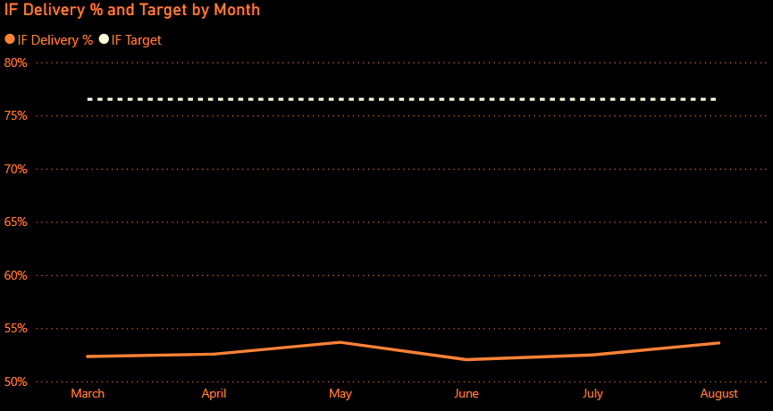
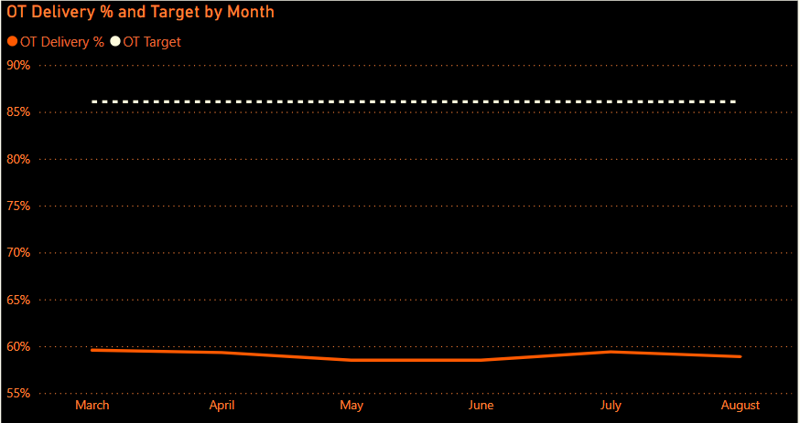
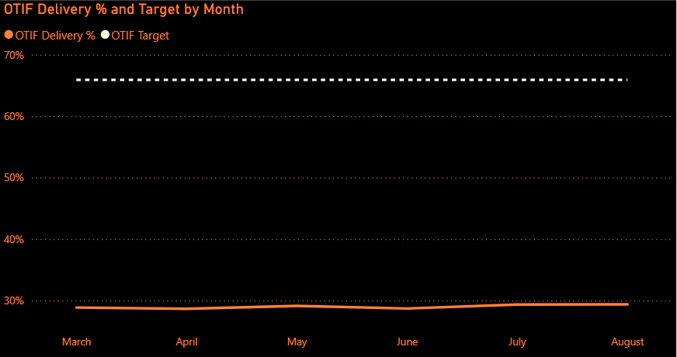
Key insights
Service Level Analysis
PL300-127 - Nguyen Vu Ngoc Chau
OT, IF, and OTIF percentages consistently fall short of their targets.
Each metric is approximately 30% below its respective goal.
Supply Chain Analysis

Slide 9
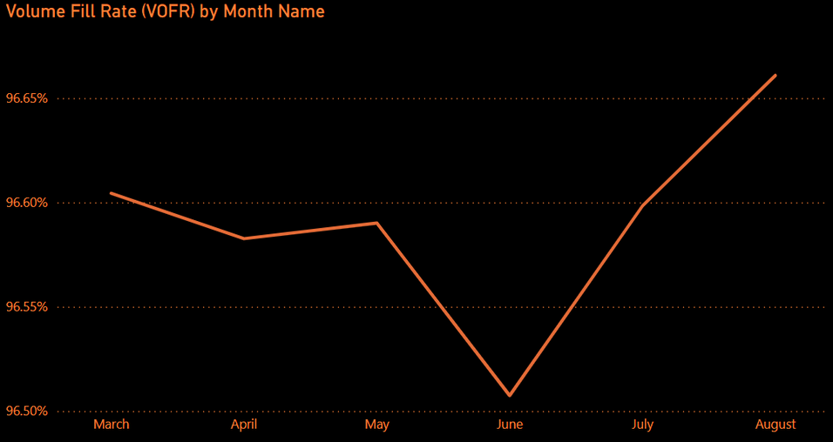
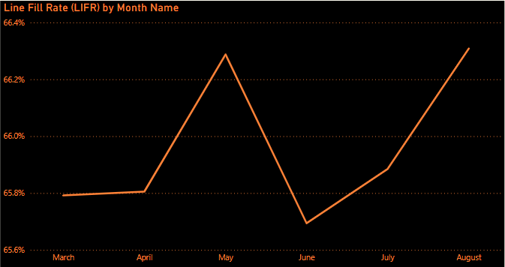
Key insights
Service Level Analysis
VOFR is strong (~96.5%) with minor fluctuations — volume fulfillment is stable.
LIFR is low (~66%) but shows slight improvement — line-level fill rate needs attention.
The gap between high VOFR and low LIFR indicates frequent partial fulfillment across order lines.
PL300-127 - Nguyen Vu Ngoc Chau
Supply Chain Analysis

Slide 10
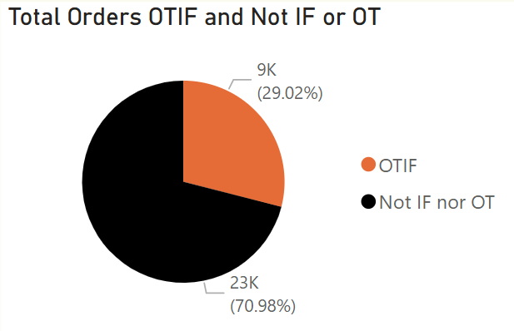
Key insights
Service Level Analysis
Around 71% of total orders are not delivered in full or on time.
PL300-127 - Nguyen Vu Ngoc Chau
Supply Chain Analysis

Slide 11
Key insights
PL300-127 - Nguyen Vu Ngoc Chau
2.
Customer Insights
Supply Chain Analysis

Slide 12
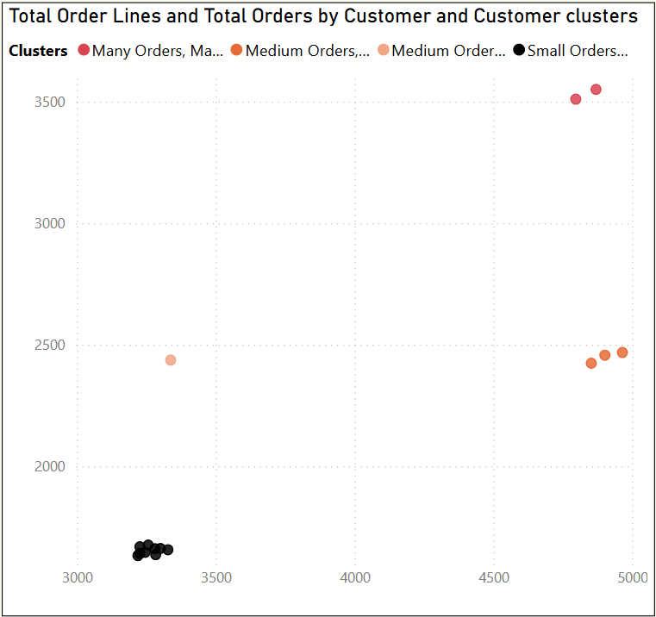
Key insights
2. Customer Insights: Key customer
PL300-127 - Nguyen Vu Ngoc Chau
Lotus Mart and Acclaimed Stores are two key customers of AlitQ Mart.
Propel Mart, Rel Fresh and Vijay Stores are customers with high potential
Supply Chain Analysis

Slide 13
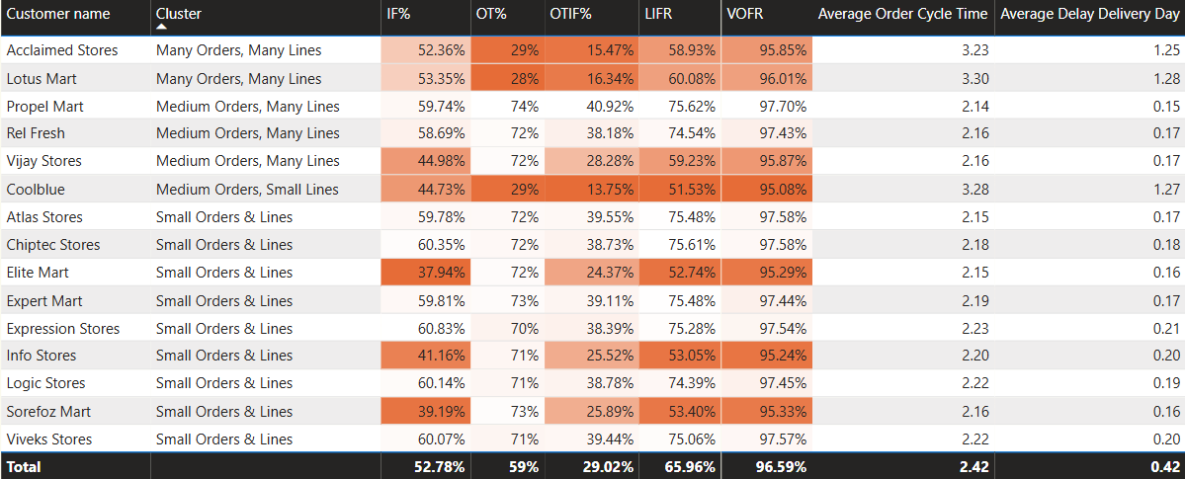
Key insights
2. Customer Insights: Delivery Performance
Back to agenda page
The metrics for Acclaimed Stores, Lotus Mart, and Coolblue are cause for serious concern.
Their IF%, OT%, OTIF%, and LIFR values are significantly below average.
These customers also experience long Average Order Cycle Times and high average delivery delays.
PL300-127 - Nguyen Vu Ngoc Chau
Supply Chain Analysis

Slide 14
Key insights
PL300-127 - Nguyen Vu Ngoc Chau
3.
Regional Insights
Supply Chain Analysis

Slide 15
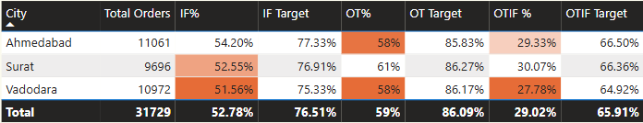
Key insights
3. Regional Insights: Delivery Performance
PL300-127 - Nguyen Vu Ngoc Chau
Vadodara shows the lowest performance across all key indicators (IF%, OT%, OTIF%). With an OTIF of just 27.78%, it poses a major concern for service reliability and customer satisfaction.
Ahmedabad follows closely as the second-lowest performer, with the lowest OT% (58%) and only marginally better IF% and OTIF% than Vadodara.
Surat performs slightly better but still fails to meet target benchmarks.
→ Overall delivery performance is consistently below expectations across all cities.
Supply Chain Analysis

Slide 16
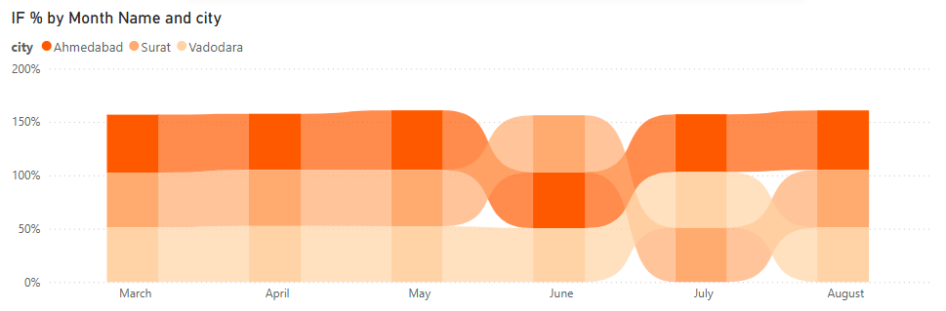
Key insights
3. Regional Insights: Comparing Performance
PL300-127 - Nguyen Vu Ngoc Chau
For the majority of the surveyed period:
IF performance was led by Ahmedabad.
Supply Chain Analysis

Slide 17
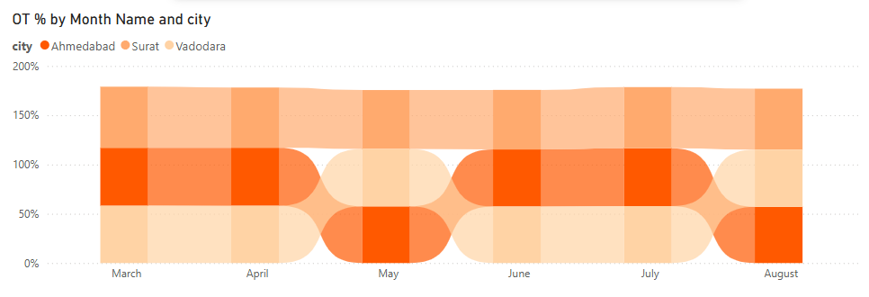
Key insights
3. Regional Insights: Comparing Performance
PL300-127 - Nguyen Vu Ngoc Chau
For the majority of the surveyed period:
IF performance was led by Ahmedabad.
Supply Chain Analysis
OT performance was led by Surat.

Slide 18
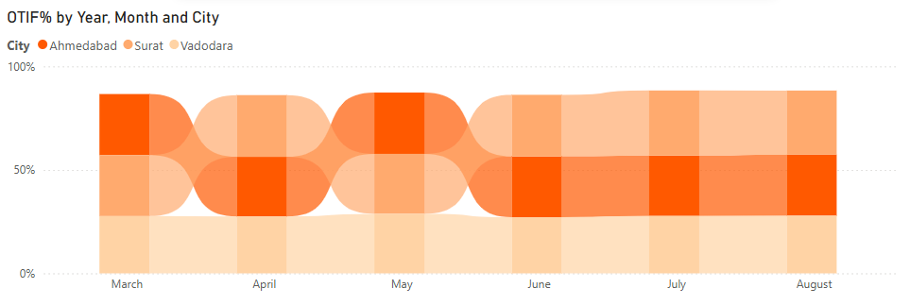
Key insights
3. Regional Insights: Comparing Performance
PL300-127 - Nguyen Vu Ngoc Chau
For the majority of the surveyed period:
IF performance was led by Ahmedabad.
Supply Chain Analysis
OT performance was led by Surat.
OTIF performance was led by Surat.

Slide 19
Key insights
PL300-127 - Nguyen Vu Ngoc Chau
4.
Regional Delay Insights
Supply Chain Analysis

Slide 20
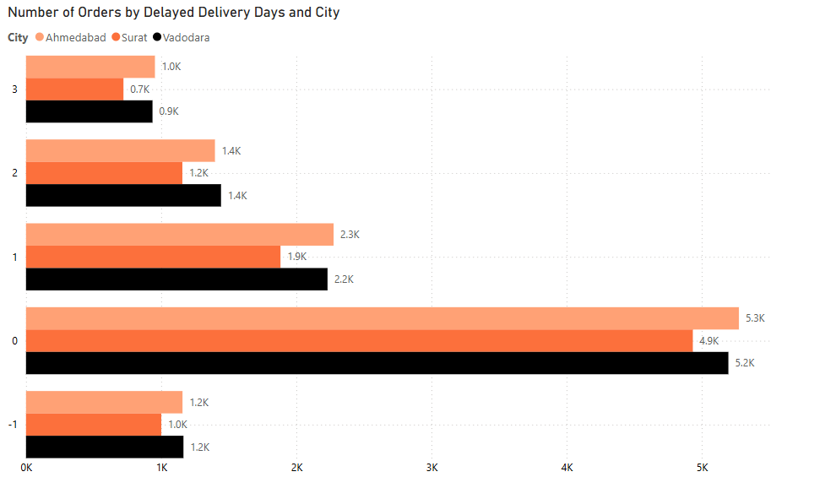
Key insights
4. Regional Delay Insights
PL300-127 - Nguyen Vu Ngoc Chau
Most orders were delivered on time, with Ahmedabad slightly leading.
1–3 day delays remain significant across all cities.
Early deliveries (Day -1) suggest potential misalignment with customer expectations.
Supply Chain Analysis

Slide 21
Key insights
PL300-127 - Nguyen Vu Ngoc Chau
5.
Product Insights
Supply Chain Analysis

Slide 22
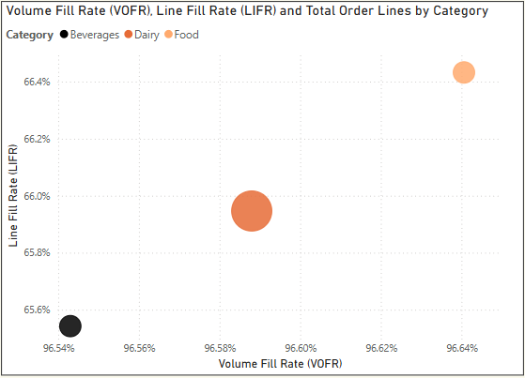
Key insights
5. Product Insights: Performance by Category
PL300-127 - Nguyen Vu Ngoc Chau
Dairy is the most ordered category but has a lower Line Fill Rate (LIFR) compared to Food.
Food has the highest LIFR and Volume Fill Rate (VOFR) among the three categories.
Beverages have the lowest LIFR and VOFR.
Supply Chain Analysis

Slide 23
Key insights
PL300-127 - Nguyen Vu Ngoc Chau
6.
Product Fill Rates
Supply Chain Analysis

Slide 24
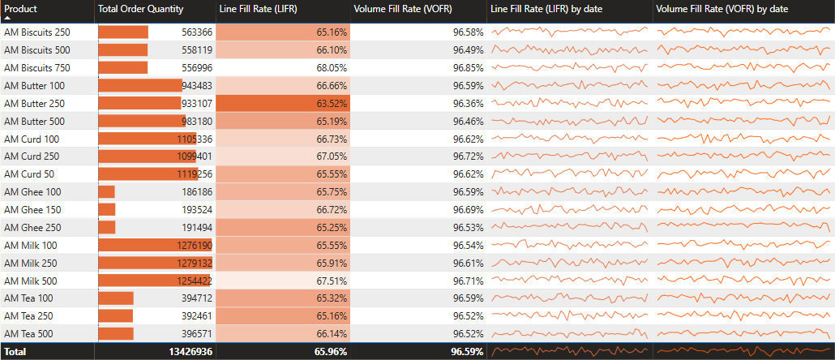
Butter 250 has the lowest LIFR, followed by Butter 500, Biscuits 250, and Tea 250.
While VOFR is high, the low LIFR indicates that full lines are not being consistently fulfilled.
6. Product Fill Rates: All Products
PL300-127 - Nguyen Vu Ngoc Chau
Supply Chain Analysis

Slide 25
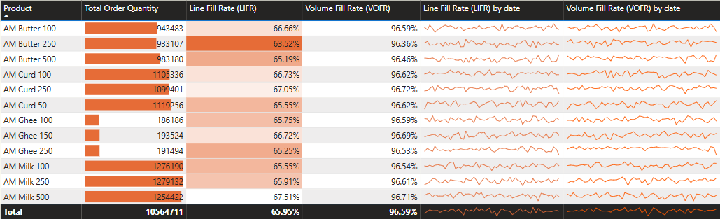
6. Product Fill Rates:
Closer Look in Dairy Products
Milk is the most ordered product, with Curd and Butter also having high order volumes.
Most Dairy products have low LIFR, averaging around 65%.
PL300-127 - Nguyen Vu Ngoc Chau
Supply Chain Analysis

Slide 26
PL300-127 - Nguyen Vu Ngoc Chau
Suggestions for Actions
Supply Chain Analysis

Slide 27
Suggestions for Actions
PL300-127 - Nguyen Vu Ngoc Chau
Investigate the inventory system → Identify root causes like inaccurate stock levels, poor warehouse organization, or outdated software.
Improve inventory management by using real-time stock tracking systems and organizing the warehouse efficiently → Quicker access to high-demand items.
Use demand forecasting tools to adjust production schedules and warehouse organization.
→ Ensuring sufficient stock and on-time delivery to customers.
Focus on dairy product demand to adjust production volumes.
Prioritize fulfilling the demands of Lotus Mart and Acclaimed Stores while nurturing the potential of Propel Mart, Rel Fresh, and Vijay Stores, without neglecting other customers' needs.
Supply Chain Analysis

Slide 28

Thank you for listening!

Slide 29
